Slide 1
Task 2: Ethical Hacking Internship
Mayuresh Atul Joshi

Slide 2
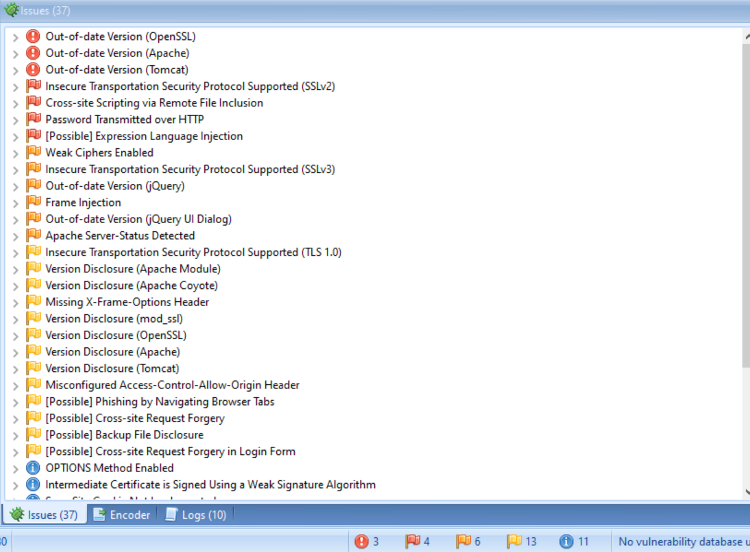
Netsparker found vulnerabilities

Slide 3
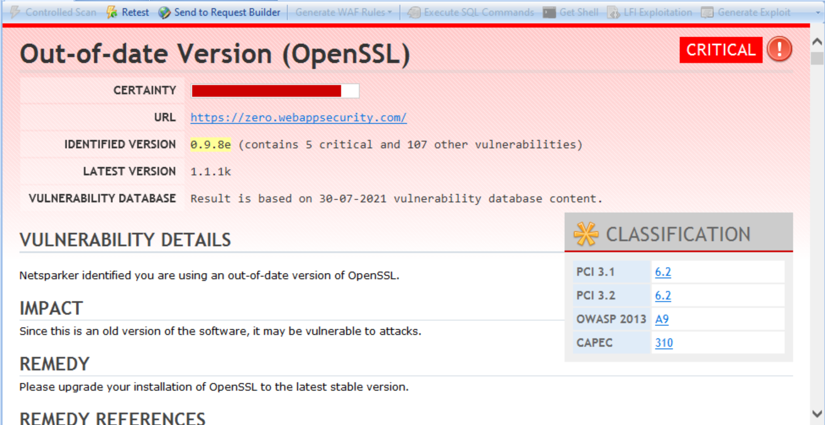
Netsparker Report

Slide 4
Personal report

